Slide 1
Version Control like GitHub
FINAL PROJECT REVIEW ADITYA ROHILLA(18BCE0929)
SOFTWARE ENGINEERING (CSE3001) D VENKATA RAJESWARA ADITYA(18BCE0949)
WINTER SEM 2020-21

Slide 2
ABSTRACT
As we know that a software product is developed in collaboration by a group of developers they might be located at different locations and each one of them contributes in some specific kind of functionality/features. So in order to contribute to the product, they made modifications in the source code(either by adding or removing).
A version control system is a kind of software that helps the developer team to efficiently communicate and manage(track) all the changes that have been made to the source code along with the information like who made and what change has been made.

Slide 3
PURPOSE OF PROHUB
Multiple people can work simultaneously on a single project. Everyone works on and edits their own copy of the files and it is up to them when they wish to share the changes made by them with the rest of the team.
It also enables one person to use multiple computers to work on a project, so it is valuable even if you are working by yourself.
It integrates the work that is done simultaneously by different members of the team.
Prohub provides access to the historical versions of a project. This is insurance against computer crashes or data loss. If any mistake is made, you can easily roll back to a previous version.
Enhances the project development speed by providing efficient collaboration

Slide 4
PRODUCT DESCRIPTION
The Prohub software that is to be developed by us is a complete code hosting platform for version control and collaboration. It lets you and others work together on projects from anywhere. Good planning is the bedrock of every successful software development project. Our product’s aim is to provide effective software to create and collaborate for projects in the form of an easy-to-use and user-friendly web application that fulfills the requirements mentioned.

Slide 5
TECHNICAL SPECIFICATION
We used Apache and PHP servers for hosting the website.
APACHE:- The open-source web server Apache is the most widely used server worldwide for the delivery of web content. The server application is made available as free software by the Apache Software Foundation.
PHP: The server-side programming language PHP enables users to create dynamic websites or applications. PHP can be installed on all platforms and supports a number of diverse database systems.

Slide 6
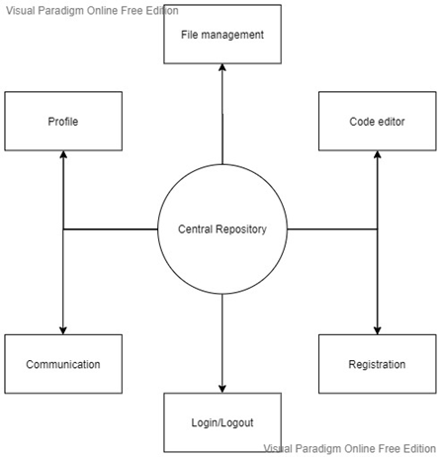
ARCHITECTURE DIAGRAM

Slide 7
DEPENDENCY DESCRIPTION
Independent Modules
● Profile Module: This module collects data from the user to uniquely identify everyone on the platform
● Editor Module: This module is used to edit the project files that the user has uploaded on the platform if the user needs to change something.
● File Manager Module: This module manages all the file i/o operations like upload and download etc.

Slide 8
Dependent Modules
● Authentication Module: This module authenticates users to access their respective repositories. It also enables users to manage their profile/identity on the platform.Depends on the data received from profile module.
● Version Control Module: This module receives vcs commands and executes requested operations. Depends on the file management module.
● Communication Module: This module manages the discussions and wiki comments section. Depends on profile and file management module

Slide 9
COST ANALYSIS
Since All the tools used are Open Source therefore they are free of cost to use. So the total Project cost is free.
For hosting the website for the public domain we need to take the services of Hostinger/Godaddy which cost around 79/mo - 599/mo
TOOLS USED | OPEN SOURCE/COST
Creatly | Open Source (FREE)
Visual Paradigm | Open Source (FREE)
StarUML | Open Source (FREE)
Xampp | Open Source (FREE)

Slide 10
RESULTS AND FUTURE WORKS
We were able to create a File management platform for developers with all the Functionalities. We also hosted and tested the Beta version in localhost for testing all the functionalities.
We will work more on the Front-end part for making the Prohub Application as a finished web application and host it for the public domain by purchasing the web hosting domain on Godaddy. Also, we will be working on adding the version control functionalities and testing them before launching the final website.

Slide 11
THANK YOU!

